Slide 1
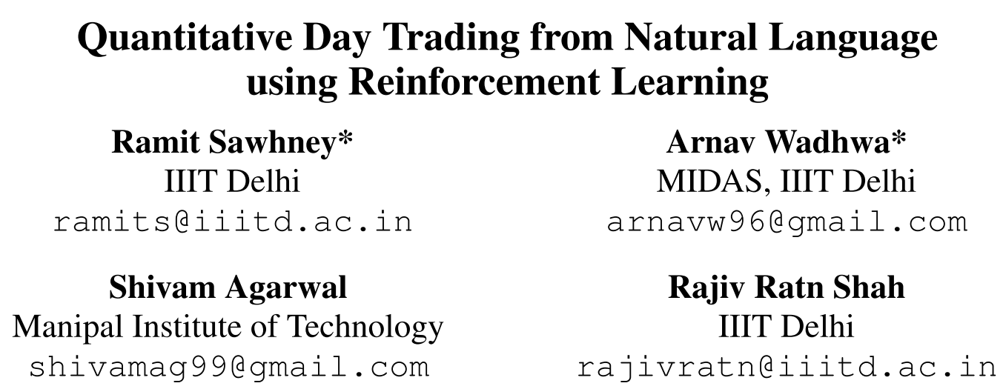
Chongqing University of Technology
ATAI
Advanced Technique of Artificial Intelligence
Chongqing University of Technology
NAACL_2021
https://github.com/midas-research/profit-naacl
Hongyang Song

Slide 2
Outline
Motivation
Approach
Experiments
Conclusion

Slide 3
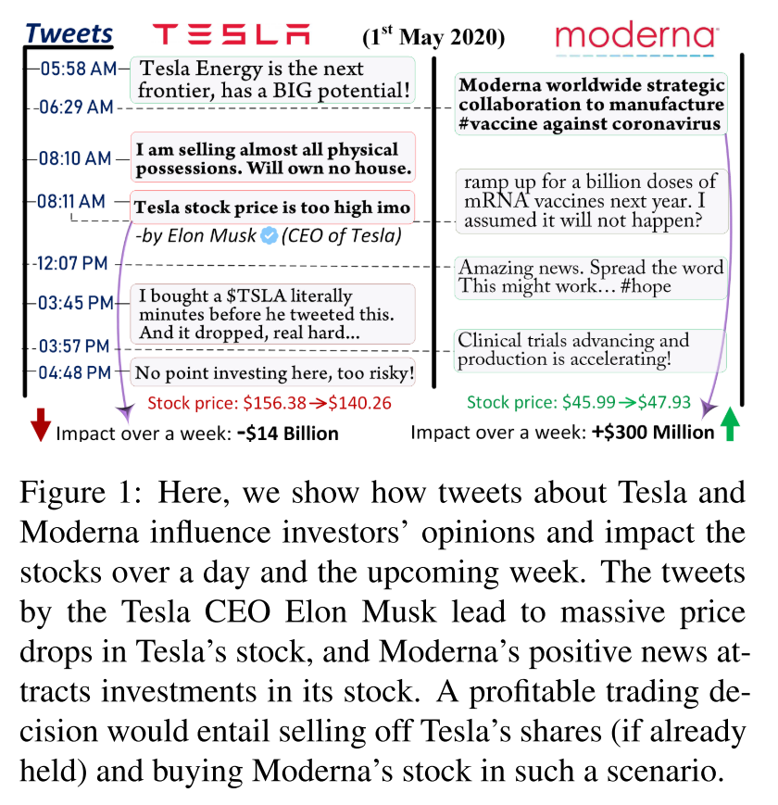
Motivation

Slide 4
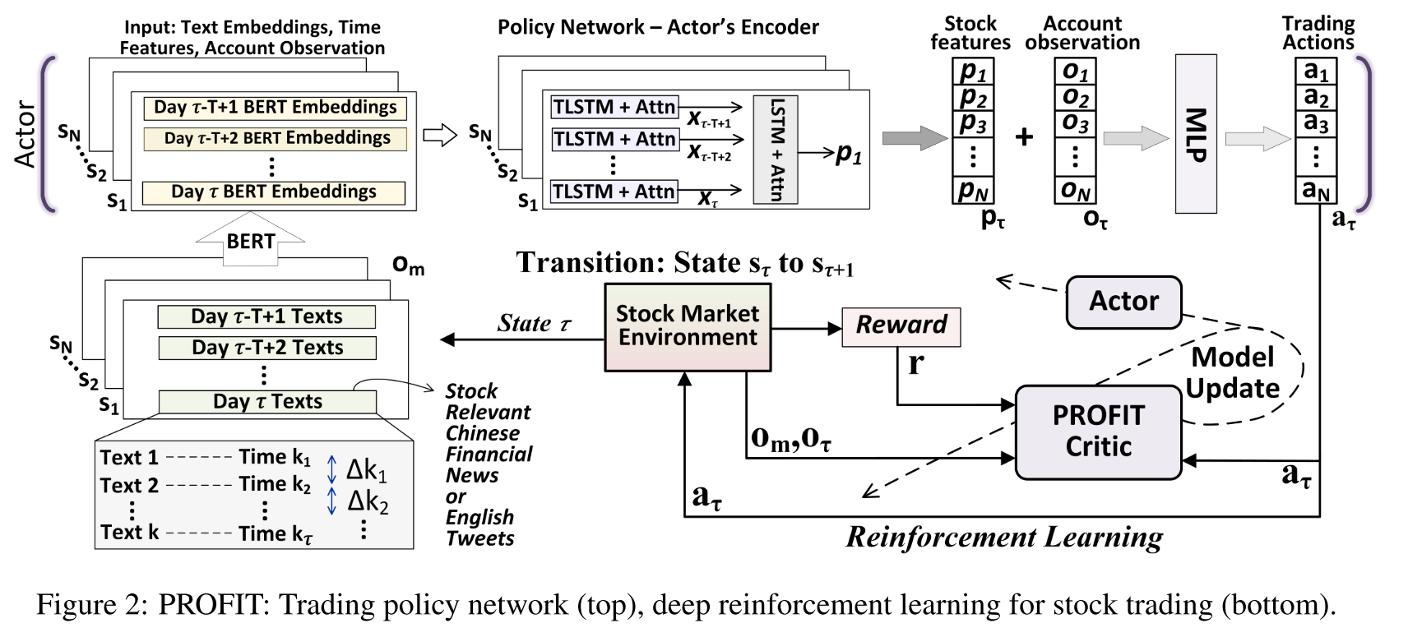
Approach
KDD_2017_Patient Subtyping via Time-Aware LSTM Networks

Slide 5
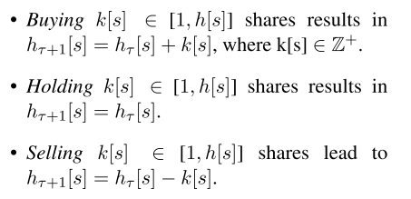
Approach

Slide 6
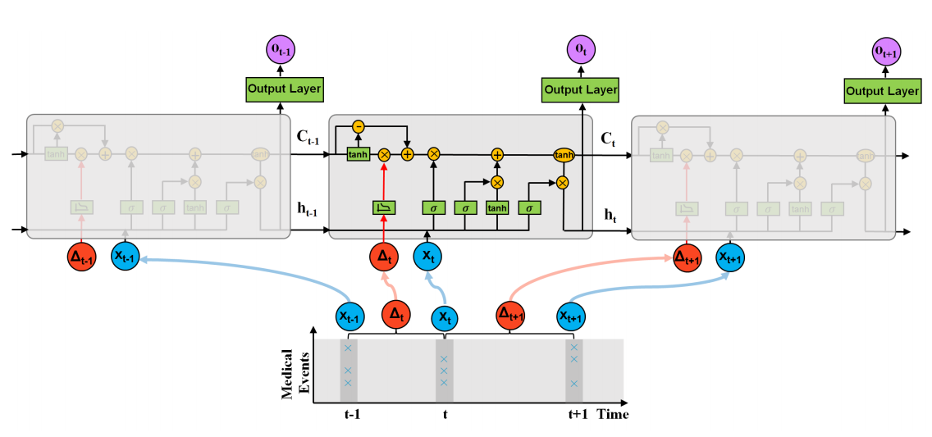
Approach
KDD_2017_Patient Subtyping via Time-Aware LSTM Networks

Slide 7
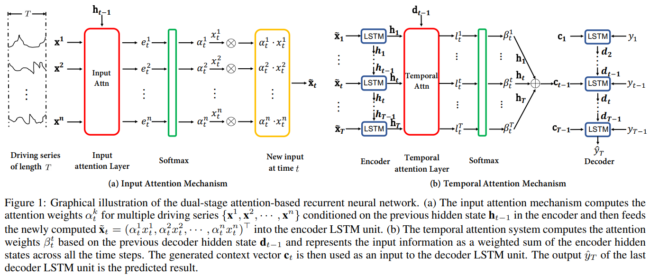
Approach
IJCAI_2017_A Dual-Stage Attention-Based Recurrent Neural Network for Time Series Prediction

Slide 8
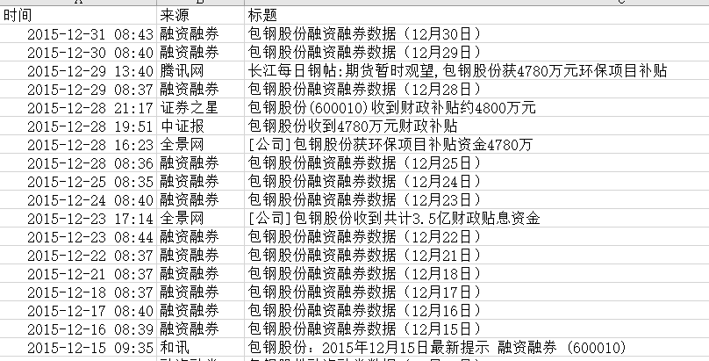
Experiments

Slide 9
Experiments
Notes:
CR: 累计回报
SR: 利润
MDD: 投资风险

Slide 10
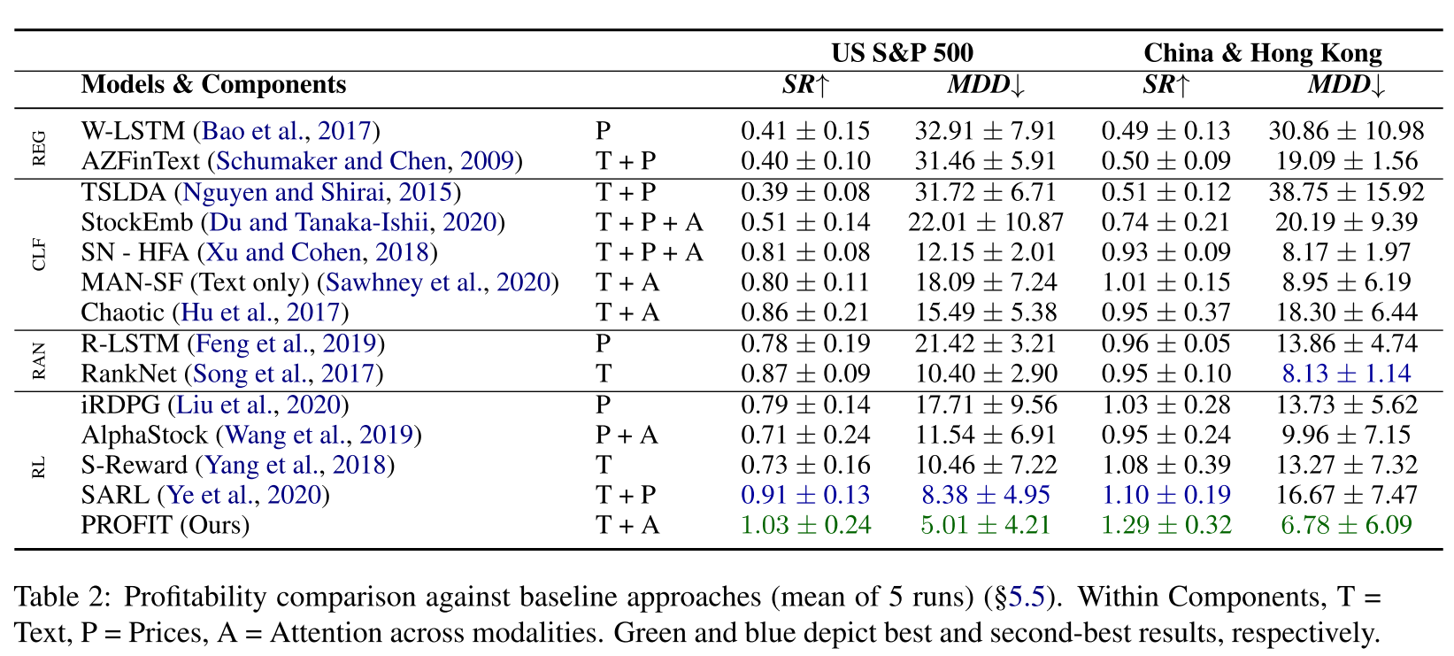
Experiments

Slide 11
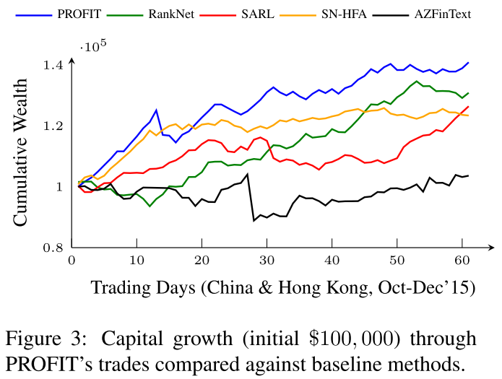
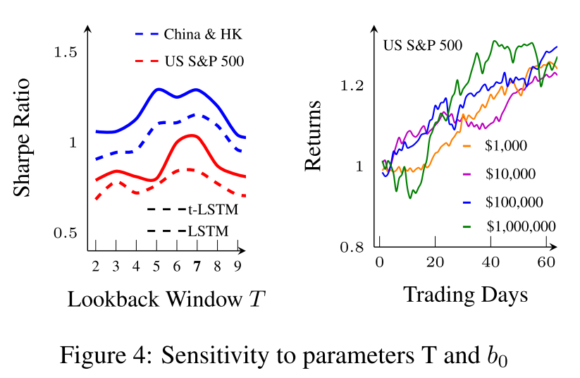
Experiments

Slide 12
Thanks

